Slide 2
Notes:
last summer I’ve been busy with an internship at Microsoft Research (together with Andrew Begel)

Slide 3
Facilitating Enterprise Software Developer Communication with CARES
Anja Guzzi
Delft University of Technology - The Netherlands
Andrew Begel
Jessica K. Miller
Krishna Nareddy
Microsoft Research - USA
Notes:
it all started last summer, with an internship at Microsoft Research (together with Andrew Begel)

Slide 4
June, 2011
Anja Guzzi
t-anguz@microsoft.com
Office 99/3345
Redmond, WA 98052
How can we make it easier for developers to communicate with each other (about code)?
Anja:
Devs
Build a tool to improve communication between developers.
Build a tool to improve communication between developers.
Andrew Begel
Notes:
The focus of the Summer Project was on communication between developers
From past studies, it emerges that delayed communication (or, especially, lack of thereof) cause problems [stalling, merging, misunderstandings] and delays. [for paper: question 10 from survey]
How can we make it easier for developers to communicate with each other (about code)?

Slide 5
Timeline

Slide 7
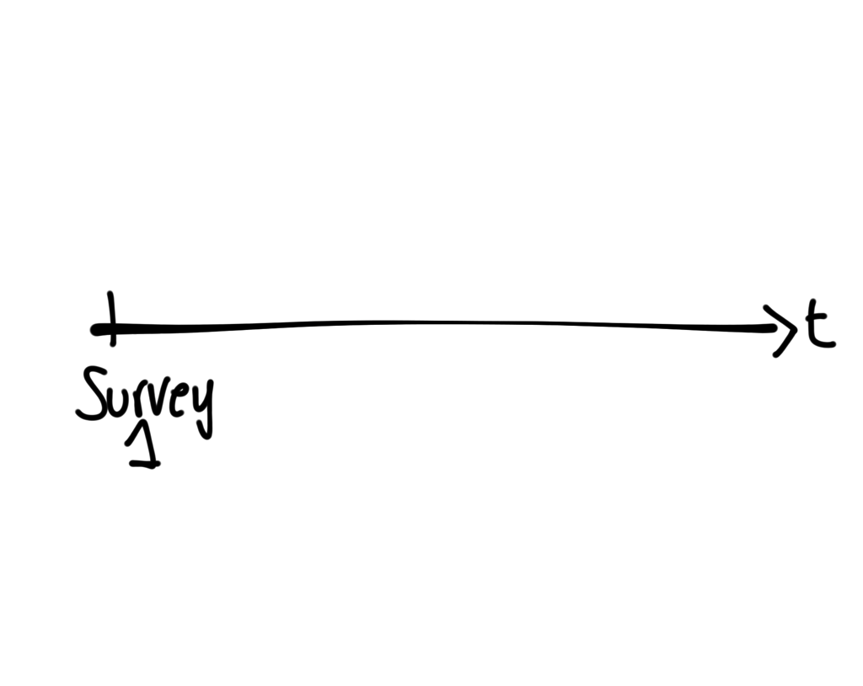
Notes:
we conducted an initial survey to inform the design of a communication tool for the developers at microsoft 94 respondents

Slide 8
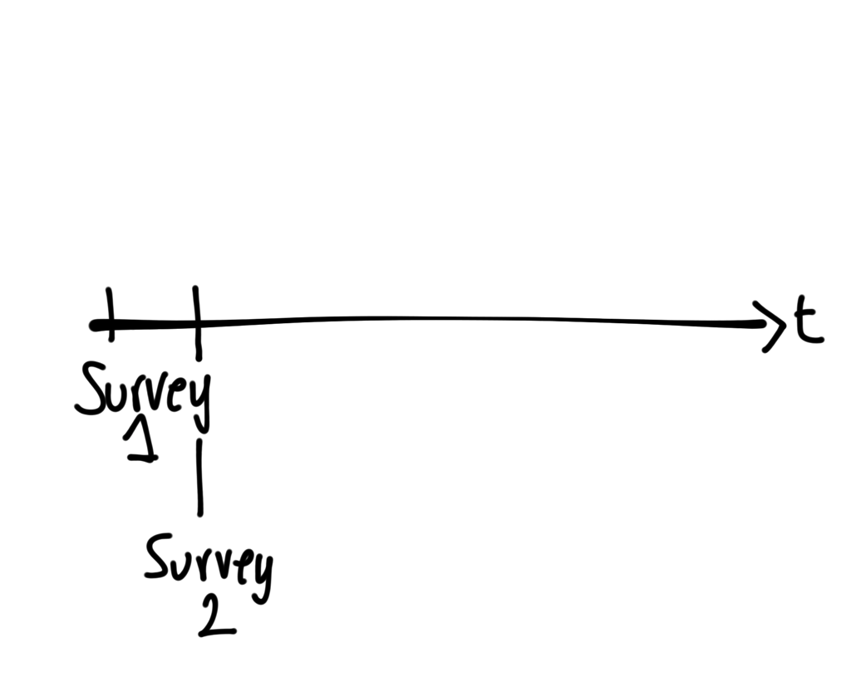

Slide 9
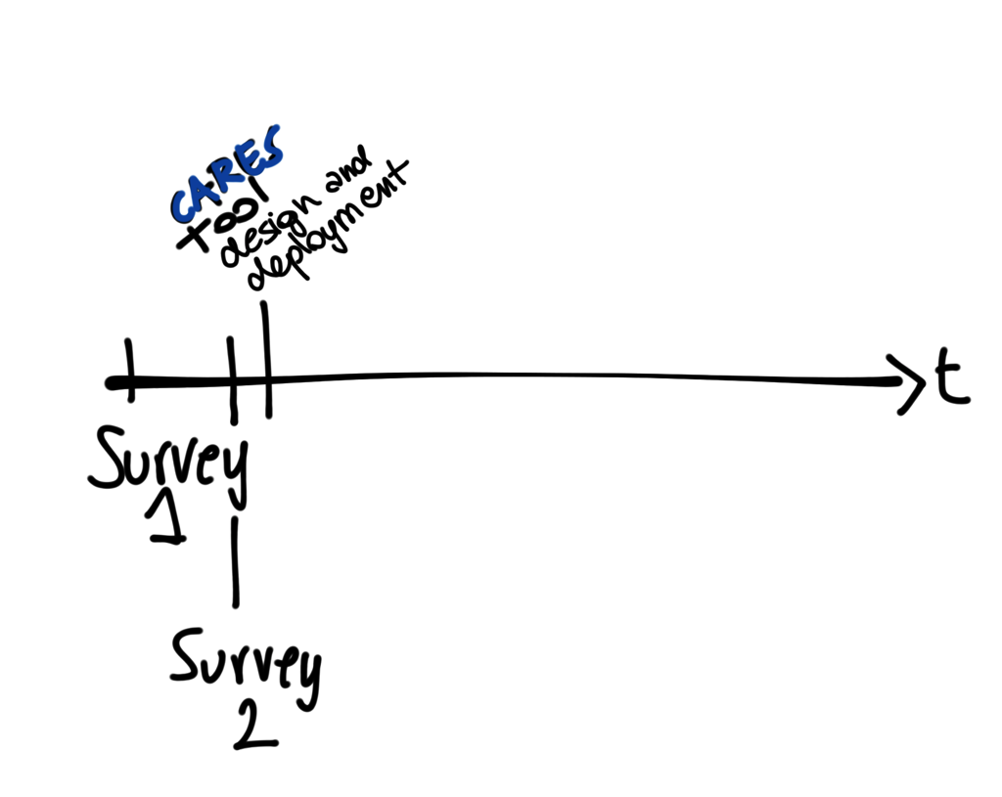

Slide 10
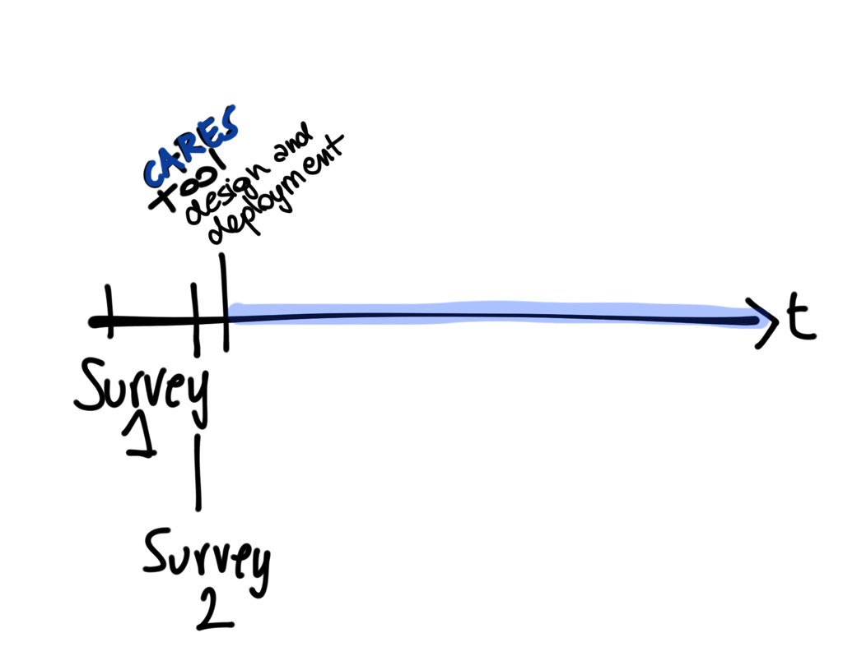

Slide 12
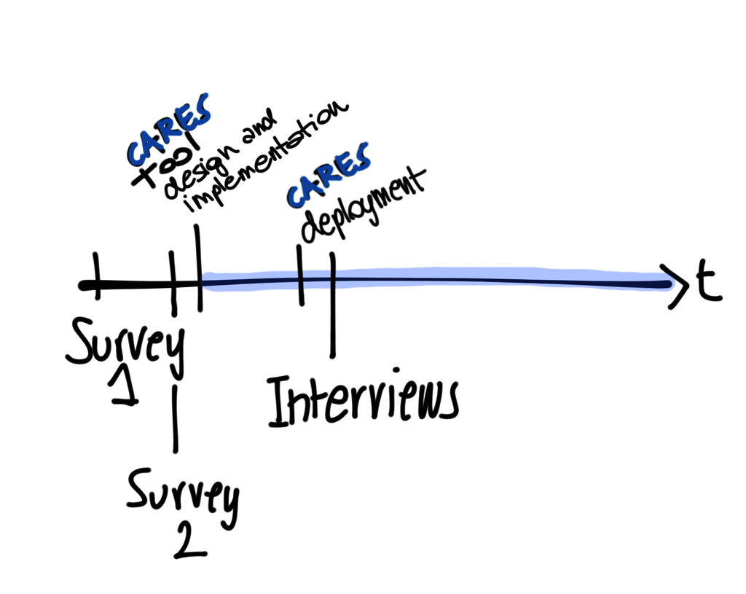

Slide 13
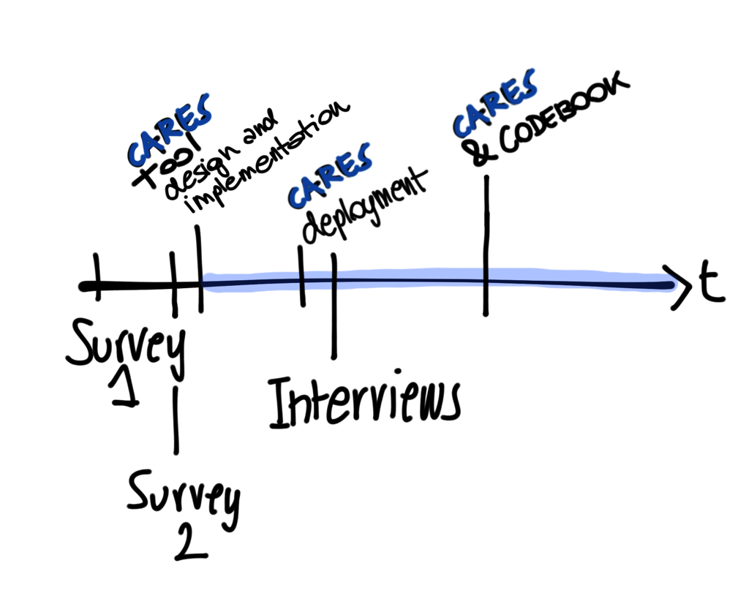

Slide 14
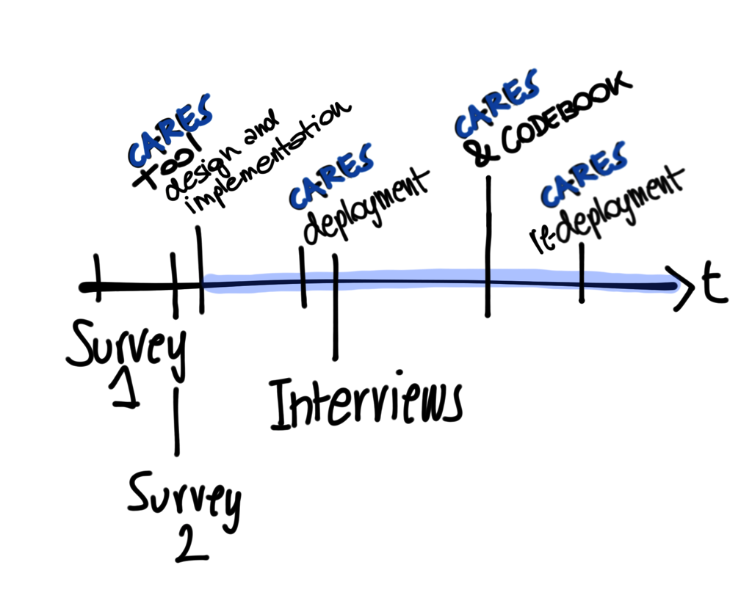

Slide 15
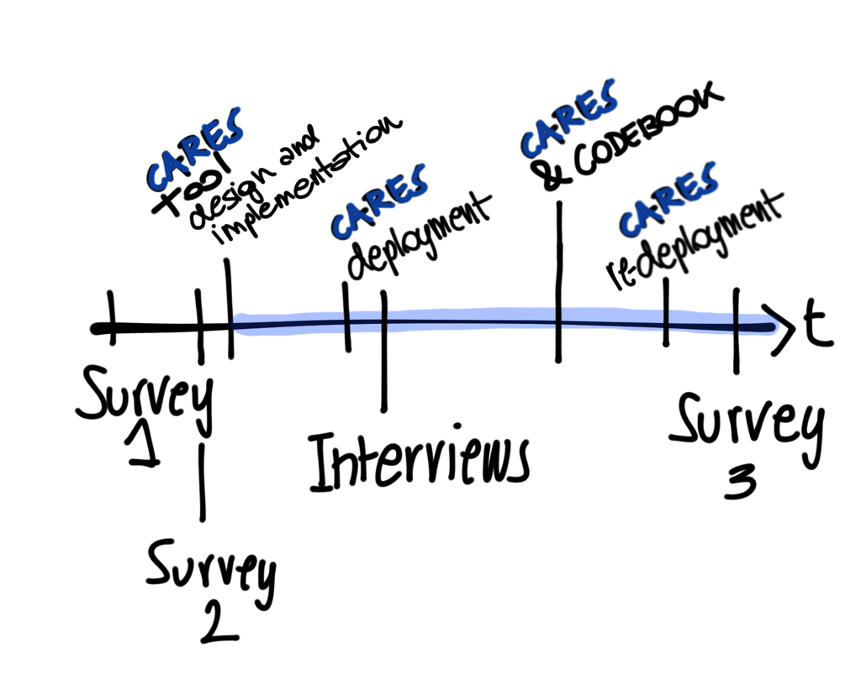

Slide 16
Communication

Slide 17
Communication

Slide 18
reasons

Slide 19
Communication
Notes:
- discuss a change I want to make to the code
- know if my use case was supported by the code

Slide 20
Communication
Notes:
- ask how the code worked
- ask why the code was written that way

Slide 21
Communication

Slide 22
selecting a person

Slide 23
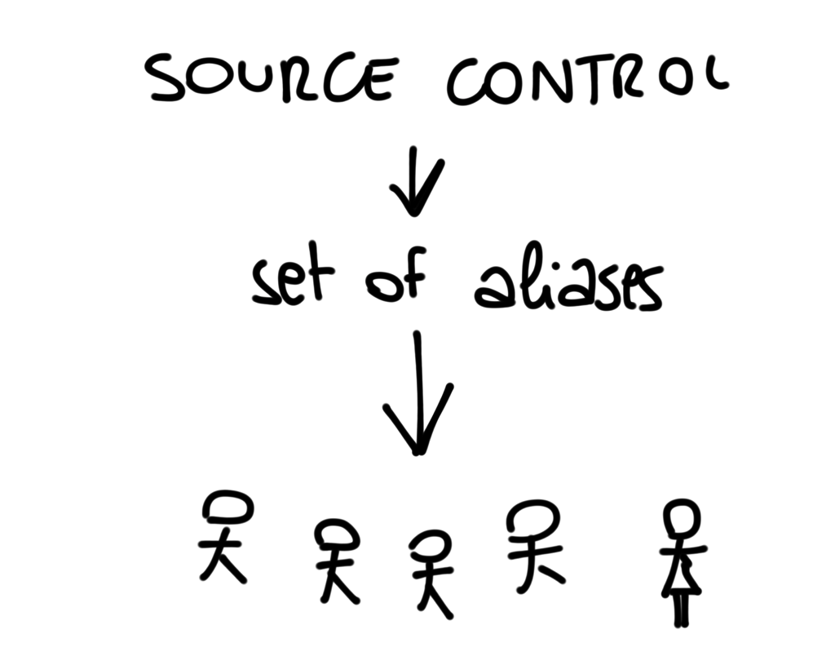

Slide 26
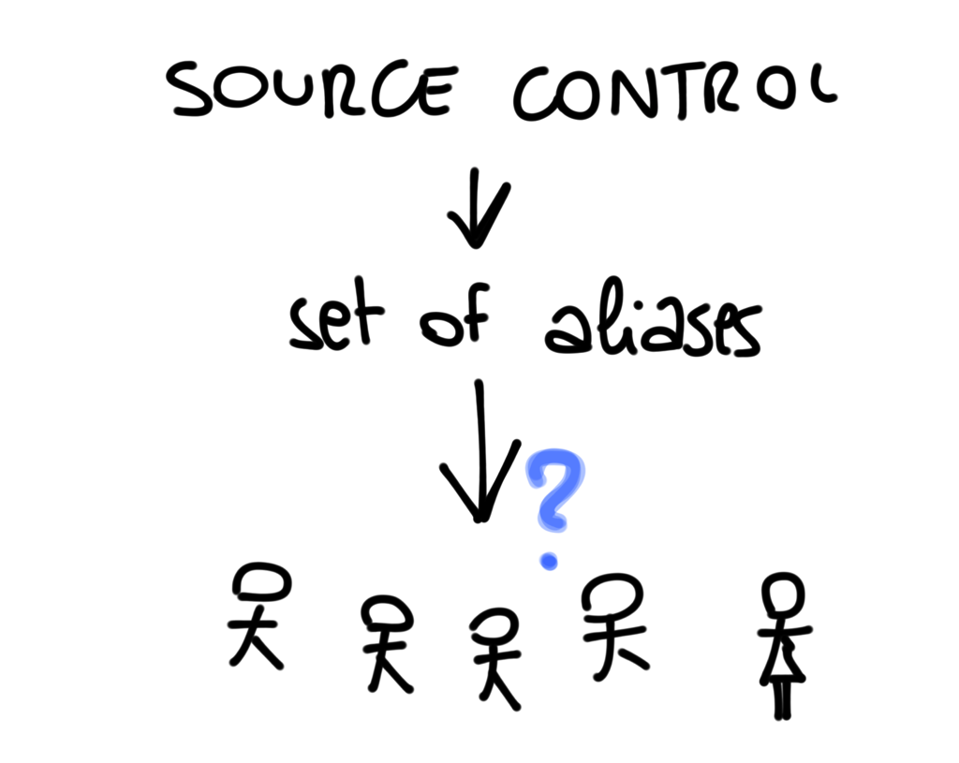

Slide 27
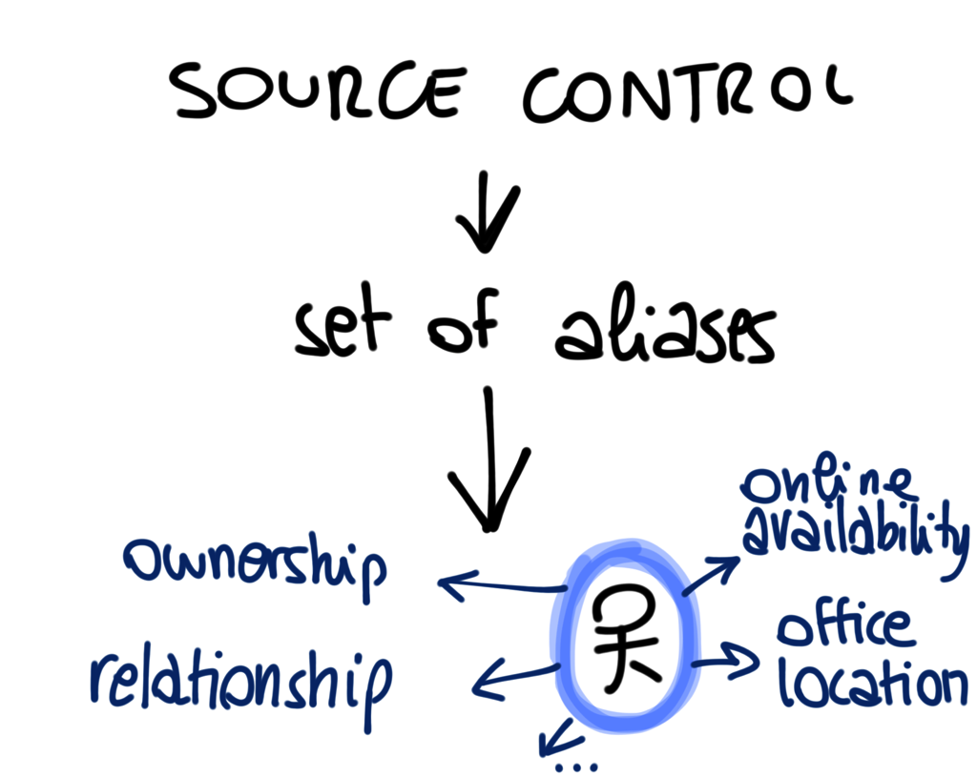

Slide 28
contacting a person

Slide 30
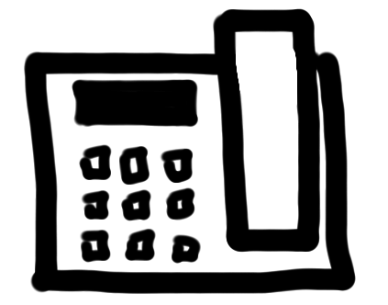
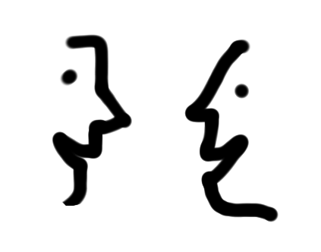

Slide 31
CARES
Visual Studio 2010 Extension
Notes:
....our spot in the design space, and we designed and build CARES, which stands for Colleguaes and Relevant Engineers Support.

Slide 32
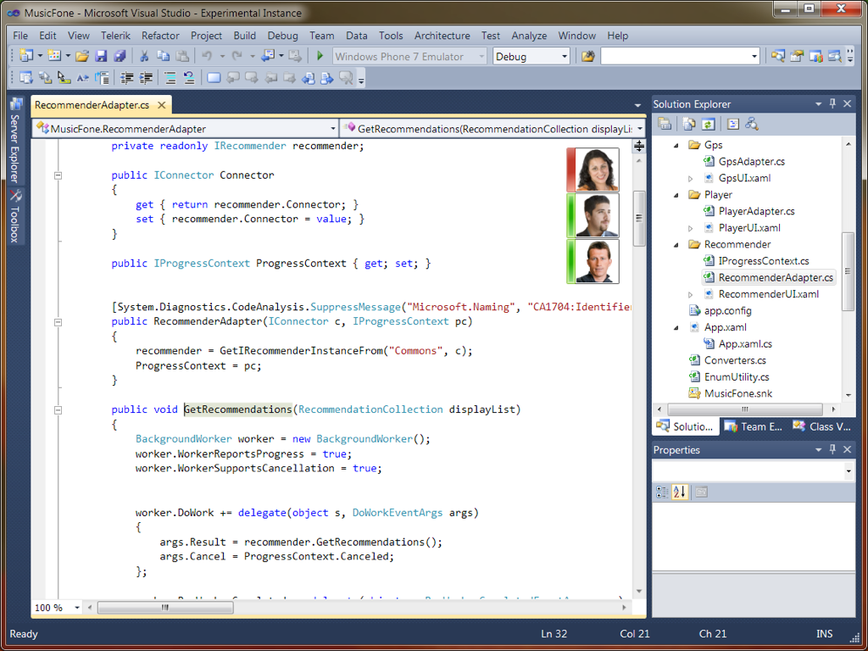
discovery
Notes:
You can see CARES in the top right corner (click)
CARES can help discovering who we can talk to if we have a question about this code,

Slide 33
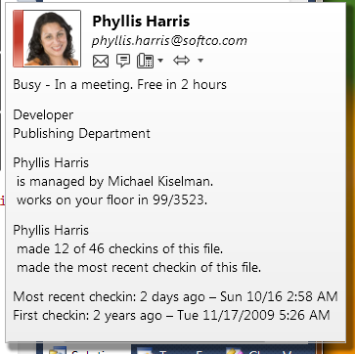
discovery
Notes:
If we hover a person with the mouse, we can see extra information that can help developers understand who each person is and who’s best to contact
For example, we we can see information about this person’s work on the file (such as how many check-ins she did)

Slide 34
initiation
Notes:
Once the developers picked the person that can best address his needs, CARES also helps him getting in touch with this person.
We do this by showing where this person works, whether she is free at the moment, and finally by providing easy one-click button to directly contact her via email, instant messages, phone or also screensharing.

Slide 35
Notes:
as shown in the timeline, CARES has been continuously improved, as we analyzed the information collected

Slide 36
Identity
Notes:
one of the biggest challenges..

Slide 37
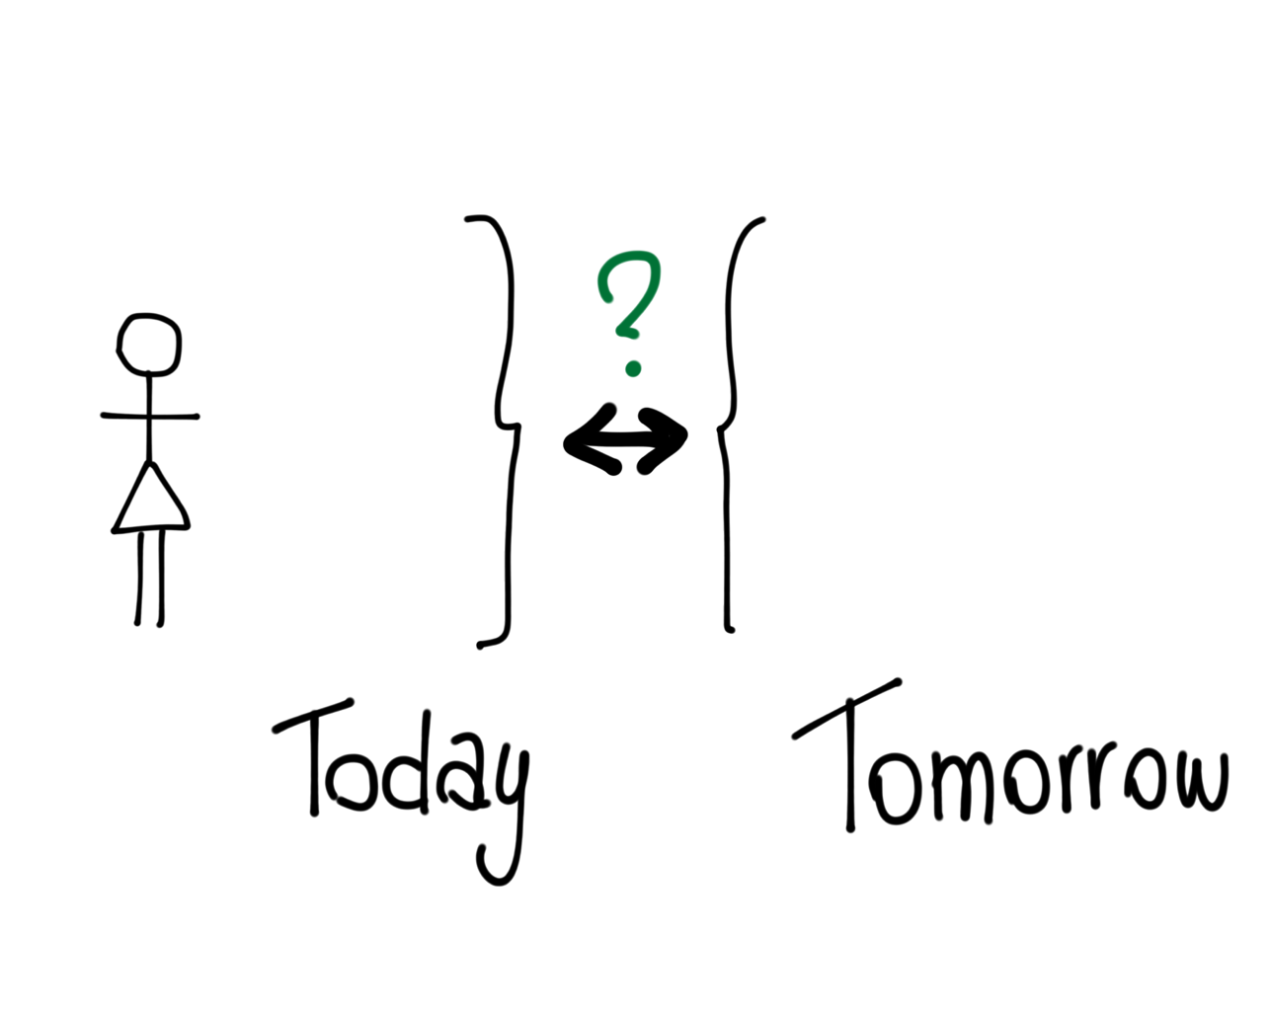
Nora Miles
n.miles@live.com
v-nora
Notes:
today/tomorrow
--------->
codebook

Slide 38
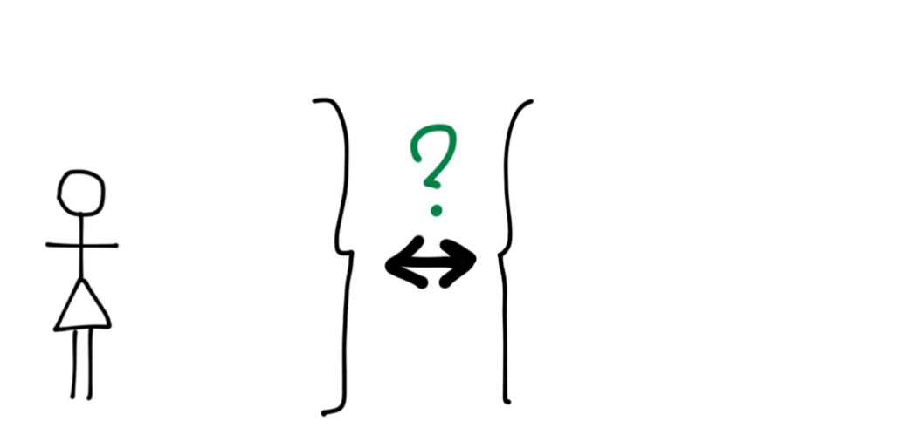
Nora Miles
n.miles@live.com
v-nora
Nora Smith
n.smith@live.com
norasmi
Notes:
today/tomorrow
--------->
codebook

Slide 39
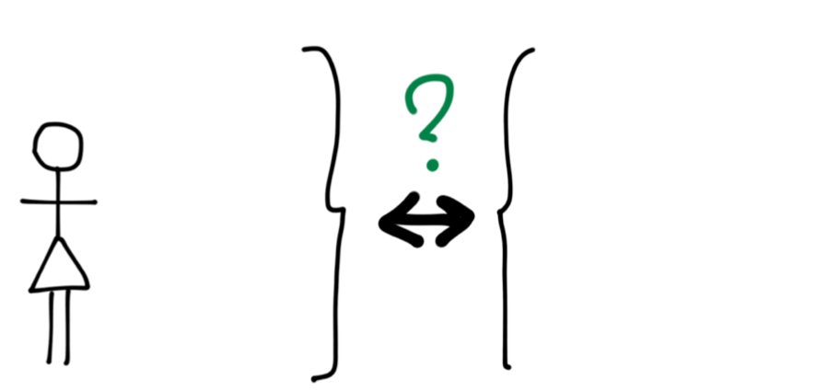
Nora Miles
n.miles@live.com
v-nora
Nora Smith
n.smith@live.com
norasmi
Notes:
today/tomorrow
--------->
codebook

Slide 40
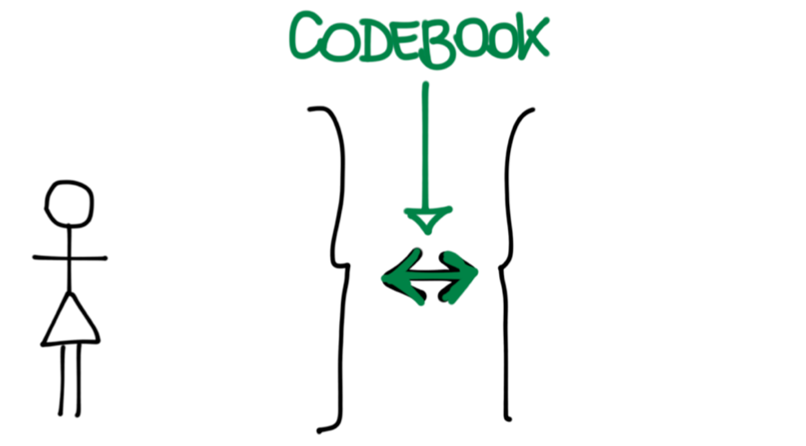
Nora Miles
n.miles@live.com
v-nora
Nora Smith
n.smith@live.com
norasmi
Notes:
today/tomorrow
--------->
codebook

Slide 41
Deployment
Notes:
survey

Slide 42
Adoption
Notes:
no second chances
zero configuration
always on
zero exceptions
graceful degradation

Slide 43
Adoption
Notes:
no second chances
zero configuration
always on
zero exceptions
graceful degradation

Slide 44
Reception

Slide 45
“CARES is pretty cool”
Reception
“It is awesome!”

Slide 46
“[It] puts a face to the code. Now I know who to talk to.”
Reception
“Seeing the faces of the contributors to the code helps me feel like I am a part of a community.”
Notes:
“Definitely easier to figure out who the people are with the faces.”

Slide 47
“[it is] handy to know who worked on that particular code, especially when it was developed years ago.”
Reception
“It’s almost always clear who the right person is to contact... I know, based on my years of experience...”

Slide 48
Summary

Slide 51
Nora Miles
n.miles@live.com
v-nora
Nora Smith
n.smith@live.com
norasmi
Notes:
today/tomorrow
--------->
codebook

Slide 52
Notes:
as shown in the timeline, CARES has been continuously improved, as we analyzed the information collected

Slide 53
Adoption
Notes:
no second chances
zero configuration
always on
zero exceptions
graceful degradation

Slide 57
Survey

Slide 58
online survey
Notes:
we conducted an initial survey to inform the design of a communication tool for the developers at microsoft --....our spot in the design space, and we designed and build CARES, which stands for Colleguaes and Relevant Engineers Support.
Design space
Functionality
Audience (coeditors, callers/callees, dependencies, ..) Message (automatic / user written)Scenario (4 scenarios from survey)UI
Scope (method, class, file, project, solution)
Impetus / what's causing the user to write a message
When to write a message? Frequent writing or rare?Attention grabbing?

Slide 59
Design

Slide 60
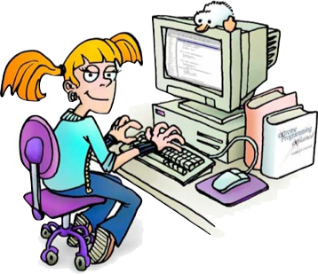
Survey (main) Results
Reasons for communicating grouped into 3 categories: coordination, seeking information, courtesy.
Ownership and contribution are the most important criteria when choosing a person to talk to.
Preference for people they already know
Conversations occur frequently (2-5 per work task; at least once a day when coding).
responses by 94 Microsoft developers
Notes:
we conducted an initial survey to inform the design of a communication tool for the developers at microsoft
coordination: e.g. communication requiring negotiation or extended interaction
seeking information
courtesy: e.g. warning someone that you are about to change their code
26% said they would pick a person they already knew
Conversations occur frequently (2-5 per work task; at least once a day when coding).
The outcome of most conversation is still relevant.

Slide 62
Summer
Internship
at Microsoft Research
Notes:
last summer I’ve been busy with an internship at Microsoft Research (together with Andrew Begel)

Slide 63
June, 2011
Anja Guzzi
t-anguz@microsoft.com
Office 99/3345
Redmond, WA 98052
How can we make it easier for developers to communicate with each other (about code)?
Anja:
Devs
Build a tool to improve communication between developers.
Build a tool to improve communication between developers.
Andrew Begel
Notes:
The focus of the Summer Project was on communication between developers
From past studies, it emerges that delayed communication (or, especially, lack of thereof) cause problems [stalling, merging, misunderstandings] and delays. [for paper: question 10 from survey]
How can we make it easier for developers to communicate with each other (about code)?

Slide 64
Survey (main) Results
Reasons for communicating grouped into 3 categories: coordination, seeking information, courtesy.
Ownership and contribution are the most important criteria when choosing a person to talk to.
Preference for people they already know
Conversations occur frequently (2-5 per work task; at least once a day when coding).
responses by 94 Microsoft developers
Notes:
we conducted an initial survey to inform the design of a communication tool for the developers at microsoft
coordination: e.g. communication requiring negotiation or extended interaction
seeking information
courtesy: e.g. warning someone that you are about to change their code
26% said they would pick a person they already knew
Conversations occur frequently (2-5 per work task; at least once a day when coding).
The outcome of most conversation is still relevant.

Slide 65
online survey
Notes:
we conducted an initial survey to inform the design of a communication tool for the developers at microsoft --....our spot in the design space, and we designed and build CARES, which stands for Colleguaes and Relevant Engineers Support.
Design space
Functionality
Audience (coeditors, callers/callees, dependencies, ..) Message (automatic / user written)Scenario (4 scenarios from survey)UI
Scope (method, class, file, project, solution)
Impetus / what's causing the user to write a message
When to write a message? Frequent writing or rare?Attention grabbing?

Slide 66
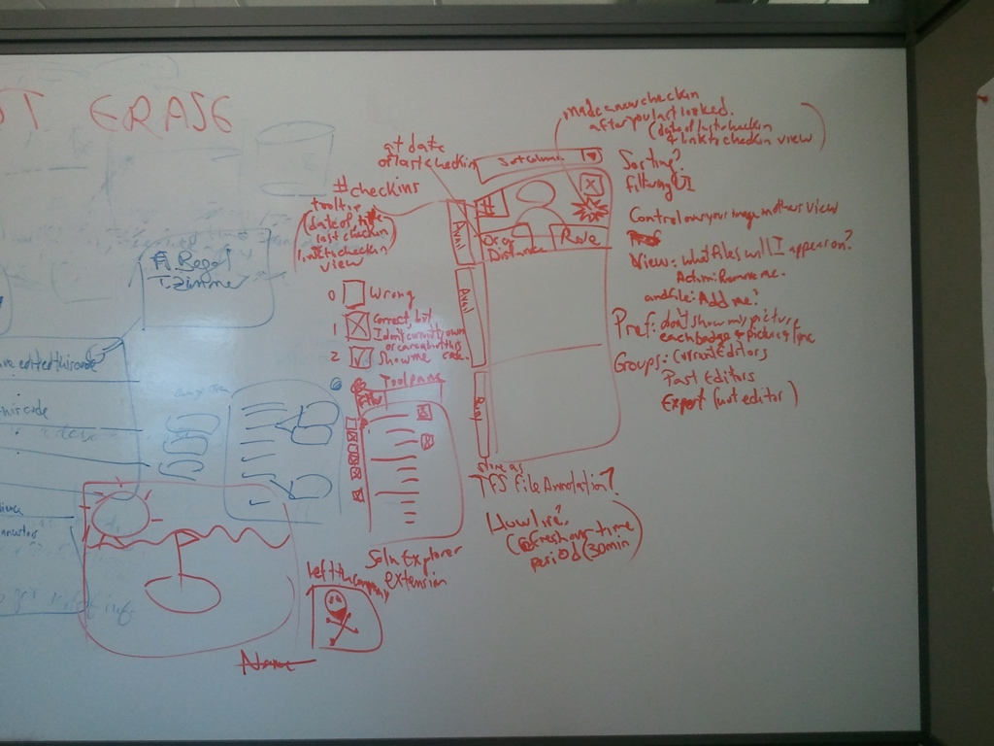
CARES
Visual Studio 2010 Extension
Notes:
and thanks to the survey result, we could pick our spot in the design space, and we designed and build CARES, which stands for Colleguaes and Relevant Engineers Support.
CARES is a Visual Studio plug-in that shows people that are relevant for the file that we are viewing
--
Design space
Functionality
Audience (coeditors, callers/callees, dependencies, ..) Message (automatic / user written)Scenario (4 scenarios from survey)UI
Scope (method, class, file, project, solution)
Impetus / what's causing the user to write a message
When to write a message? Frequent writing or rare?Attention grabbing?

Slide 67
discovery
Notes:
You can see CARES in the top right corner (click)
CARES can help discovering who we can talk to if we have a question about this code,

Slide 68
discovery
Notes:
If we hover a person with the mouse, we can see extra information that can help developers understand who each person is and who’s best to contact
For example, we we can see information about this person’s work on the file (such as how many check-ins she did)

Slide 69
initiation
Notes:
Once the developers picked the person that can best address his needs, CARES also helps him getting in touch with this person.
We do this by showing where this person works, whether she is free at the moment, and finally by providing easy one-click button to directly contact her via email, instant messages, phone or also screensharing.

Slide 70
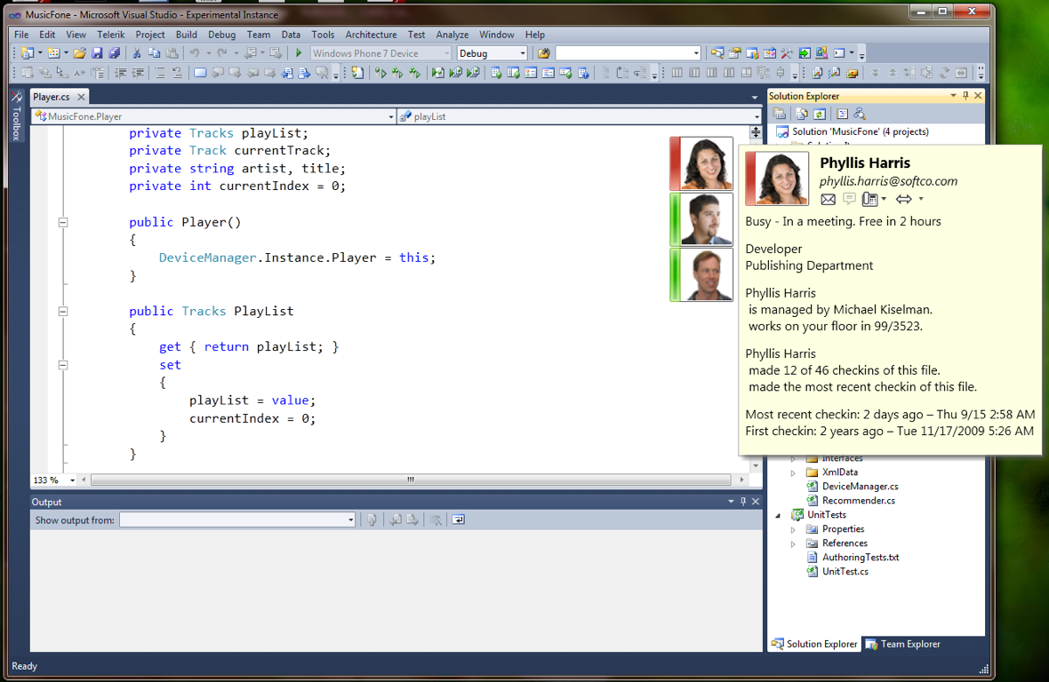
We believe that CARES makes it easier for developers to communicate with each other about code.
discovery and initiation
Notes:
CARES was deployed to microsoft employees and we conducted a few interviews with them.
and, from our preliminary results, we believe that CARES makes it easier for developers to communicate with each other about code.
--
also, we are now busy with a study of CARES usage over few weeks of use by the developers

Slide 71
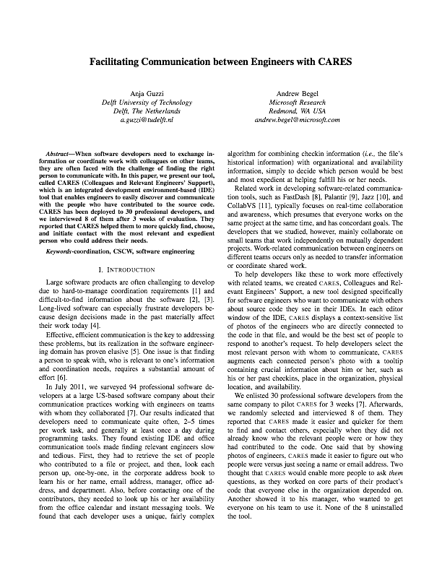
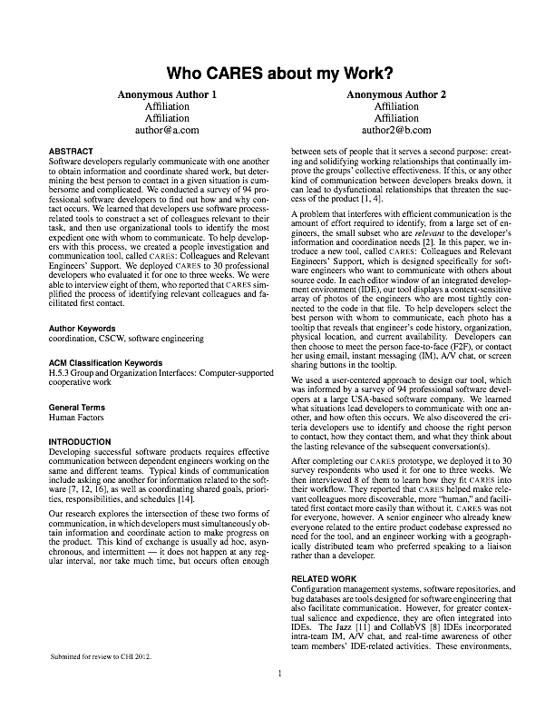
ICSE 2012 - FORMAL DEMO
Notes:
...we have a tool demo paper here at ICSE,
..and we’re also working on a full paper about CARES,..

Slide 72
Evaluation

